Slide 1
PANORAMIC
Platform Adaptive trial of NOvel antiviRals for eArly treatMent of covid-19 In the Community
Trial Team Training
Chief Investigator: Professor Chris Butler
Sponsor: University of Oxford
Funded by DHSC/NIHR
REC: 21/SC/0393 IRAS: 1004274 EudraCT: 2021-005748-31

Slide 2
Primary Aim:
To determine whether antiviral treatment in the community safely reduces the risk of hospitalisations/deaths in higher risk,
patients with confirmed COVID-19
Trial Design:
PANORAMIC is a platform, adaptive randomised clinical trial in community care.
Operates under a master protocol that allows the addition or replacement of further interventions.

Slide 3
We are looking at…
Best usual primary care
VS
Existing Novel antiviral agents (or combinations) specified by The Antivirals Taskforce (ATF)

Slide 4
Main trial objectives:
Primary Objective | Outcome Measures | Timepoint (s)
To determine whether antiviral treatment in the community safely reduces non-elective hospitalisations/ deaths in higher risk, symptomatic patients with confirmed COVID-19 | All cause, non-elective hospitalisation and/or death, within 28 days of randomisation | Within 28 days of randomisation

Slide 5
Secondary Objectives include:
Time to recovery
Duration of symptoms
Symptom recurrence
Healthcare service use
Participant reported household infection rate
Symptoms and well-being at three and six months
Safety

Slide 6
Virology sub-study:
Involves a subset of patients from the intervention and comparator arms Aim To determine if there are differences in viral load among participants in the treatment versus usual care arms To identify any common genetic mutations in patients receiving novel antiviral(s)

Slide 7
In the first instance, PANORAMIC looked at:
Usual Care
Usual Care Plus Molnupiravir
Vs

Slide 8
Currently we are looking at:
Usual Care
Usual Care Plus Paxlovid
Vs

Slide 9
Trial Medication: Paxlovid
Consists of Nirmatrelvir tablets and Ritonavir tablets
Nirmatrelvir - oral antiviral developed specifically for treatment of COVID-19. Inhibits the SARS-CoV-2 3CL protease, thereby preventing viral replication
Ritonavir - inhibits CYP3A-mediated metabolism of Nirmatrelvir thereby increasing plasma concentrations of Nirmatrelvir to therapeutic levels

Slide 10
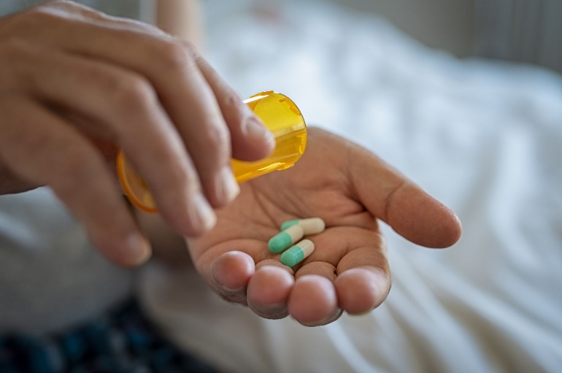
Participants randomised to the usual care plus Paxlovid arm will receive usual clinical care as per NHS guidelines, plus Paxlovid for five days
Usual recommended dosage - 300 mg Nirmatrelvir (two 150 mg tablets) with 100 mg Ritonavir (one 100 mg tablet) taken together orally twice daily for 5 days

Slide 11
Precautions
Potential SARs due to drug-drug interactions - See Appendix F in protocol for full list of contraindicated concomitant medications and concomitant medications that may be taken with caution
Hepatotoxicity - Patients with known severe liver disease not eligible
Excipients - Nirmatrelvir contains lactose. Patients with rare hereditary problems of galactose intolerance, total lactase deficiency or glucose-galactose malabsorption should not take Paxlovid

Slide 12
Fertility, pregnancy, and lactation…
Fertility
No human data on the effects of Paxlovid on fertility
Pregnancy
No human data on the effects of Paxlovid on pregnancy and pregnant women are excluded
Any pregnancy that occurs during Paxlovid administration will be reported as an AE of special interest and requires monitoring and follow-up until the outcome of the pregnancy and any postnatal sequelae are known
Breast-feeding
No human data on the effects of Paxlovid in breast-feeding
Not known whether Nirmatrelvir is excreted in human breast milk. Ritonavir is excreted in breast milk but the effect on breast milk production and on the new-born, infant is not known
Breastfeeding women are therefore excluded

Slide 13
Target Population: Patients not automatically eligible for Paxlovid under limited deployment criteria
Patients aged ≥18-49 years and clinically vulnerable - any one of the following:
chronic respiratory disease (including chronic obstructive pulmonary disease (COPD), cystic fibrosis and asthma requiring at least daily use of preventative and/or reliever medication)
chronic heart or vascular disease
chronic kidney disease
chronic liver disease
chronic neurological disease (including dementia, stroke epilepsy)
severe and profound learning disability,
Down’s syndrome
Diabetes mellitus (Type or Type II)
immunosuppression: primary
solid organ, bone marrow and stem cell transplant recipients
morbid obesity (BMI >35)
severe mental illness
care home resident
judged by recruiting clinician to be clinically vulnerable
OR Patients aged ≥50 with or without a co-morbidity

Slide 14
Inclusion Criteria: Paxlovid
In addition to being clinically vulnerable and/or > 50 years of age…
Able and willing to provide informed consent, or their legal representative is willing to provide informed consent
Symptoms attributable to COVID-19 started within the past 5 days and ongoing
A positive PCR or lateral flow SARS-CoV-2 test (taken up to two days before symptom onset and randomisation)
Willing to take a pregnancy test after randomisation and prior to starting Paxlovid treatment (participants of childbearing potential)
Patients with known mild kidney disease (CKD) stage 2, must have an eGFR measurement taken in the past 6 months

Slide 15
Exclusion Criteria: Paxlovid
Currently admitted to hospital
Previous randomisation in the PANORAMIC trial
Currently participating in a clinical trial of a therapeutic agent for acute COVID-19
Known or suspected pregnancy
Currently breastfeeding
Capable of becoming pregnant and do not confirm a negative pregnancy test prior to starting the drug, and/or aren’t willing to use one of the following contraceptive methods for the 28-day duration of follow-up in the trial:
Sterilisation, long-acting reversible contraceptive (LARC) methods (intrauterine devices, intrauterine systems, and implants), or the progestogen only pill or injection, for the 28-day duration of follow-up in the trial
Combined hormonal contraception (oral, transdermal, or intravaginal) alongside an additional barrier method (e.g., male condom) for the duration of Paxlovid treatment, and until after one complete menstrual cycle after stopping Paxlovid
Abstinence: for the 28 days before enrolling in the trial and 28-day duration of follow-up
Note: a barrier method on its own is not sufficient

Slide 16
Exclusion Criteria continued…
History of clinically significant hypersensitivity to the active substances in Paxlovid or to any of its excipients
Known rare hereditary problems of galactose intolerance, total lactase deficiency or glucose-galactose malabsorption
Known current severe liver impairment (characterised by severe ascites, encephalopathy, jaundice, or prolonged INR). People with liver disease without any of these features are eligible)
Known moderate or severe renal disease (defined as CKD stage 3, 4 or 5 or current acute kidney injury or most recent eGFR in the past 6 months <60 ml/min)
Currently taking Paxlovid
Taking a drug which is contraindicated or not recommended for administration with Paxlovid or are taking a drug which in the opinion of the investigator would put the subject at unacceptable risk

Slide 17
Additional exclusion criteria for those taking part in the virology sub-study:
Has received antibody therapy outside of the trial within the previous 3 months

Slide 18
Confirming Eligibility:
Confirmed through a direct discussion (face to face or remotely) between the participant and a medically qualified professional, a prescribing pharmacist or a nurse prescriber who is suitably trained and delegated this responsibility at a PANORAMIC Hub, other NHS healthcare provider or by the central clinical team.
The person confirming eligibility must take a relevant drug history and have access to a version of a summary care record and if necessary according to their clinical judgement, be able to access further information contained within secondary care records or full primary care records
If the patient is deemed eligible following these steps they may then be randomised to Paxlovid
Participants who are too unwell or unable to respond to surveys for themselves, can identify a Trial Partner to assist them in completing screening, baseline, consent and follow up online forms and/or calls and provide information to them on their behalf where necessary.

Slide 19
Taking informed Consent:
*Only medically qualified professionals, prescribing pharmacists or a nurse prescribers can take informed consent for the Paxlovid arm*
All consent forms are completed online and paperless with printed or electronic copies given to the participant.
Written and summary versions of the Patient Information Sheet (PIS), and Informed Consent Form (ICF) along with a pictorial summary are all available on the trial website
Before taking informed consent participants will:
Have a two-way discussion with suitably delegated trial staff where the risks and benefits of taking part and follow-up procedures will be explained
Be given adequate time to consider the information and ask any questions

Slide 20
Randomisation
Eligible participants will be randomised to either:
Usual Care
Standard NHS Care
Will receive an information booklet via email or post
Trial team will call participants on Day 2 to confirm the follow up process
Intervention arm
Will receive a participant pack containing:
the antiviral agent
an information booklet
medication card detailing how the medication should be administered, precautions and safety guidance
medication appendix providing further information about the treatment (available prior to randomisation as part of the PIS)
emergency contact card
pregnancy test (only for participants of child-bearing potential)
OR

Slide 21
Distribution and Tracking of Medication
The randomisation database will automatically alert the relevant IMP distributor
IMP sent directly to participants from either PANORAMIC Hubs or an accredited licensed central facility (IPS).
Trial packs will be tracked via courier or call/text message.
For further details on the distribution of each antiviral agent, please refer to the ISA.

Slide 22
Follow-up safety calls…
Made on Day 1, 2, 4 and 10 (to those randomised to take Paxlovid) to ensure the IMP has arrived, confirm negative pregnancy test (day 1), monitor for side effects and concomitant medication usage and enable the investigator to suggest changes to participants medication (including stopping where required)
Includes weekends and bank holidays
Changes to medication are also monitored in the daily diary
If the participant records starting a new medication, an automated alert will be sent to the Panoramic Safety Team
Usual care participants receive a call on day 2 to confirm the follow up process

Slide 23
Follow up: All participants
Day 1 – 28
Participants on all arms of the trial will complete a daily diary each day for 28 days
The central trial team will call participants/study partners with no internet access or those who have not completed their diary for at least two consecutive days before days 7, 14 and 28.
There will be a 24-hour phone line for participants/clinicians to speak to a clinical member of the central team
Day 29 – Onwards
Participants will be contacted at 3 and 6 months from randomisation to ascertain wellbeing and longer-term consequences of their illness.
Participants’ medical records will be accessed up to 12 months following enrolment to ascertain follow up data from enrolment to 6 months.

Slide 24
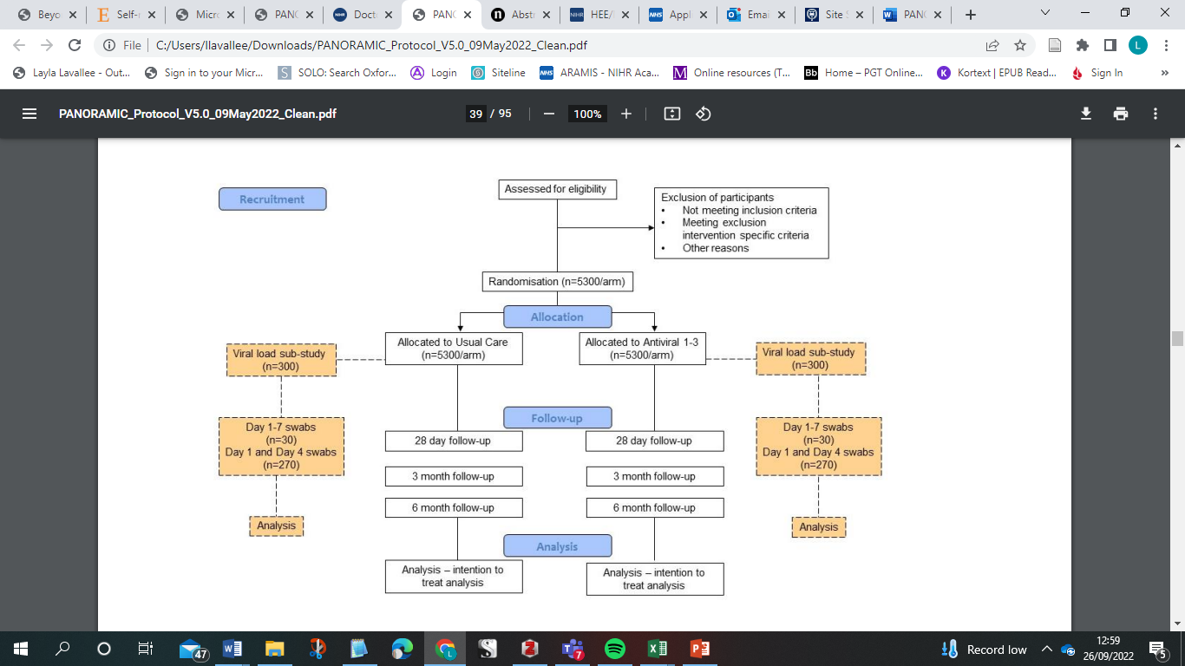

Slide 25
Adverse events
All non-COVID related events will be reported as Adverse Events (AEs) in order for us to monitor side effects of Paxlovid
There are questions in the safety call CRFs that will prompt questions about symptoms. If any of these questions are completed, this will prompt the completion of an AE form
The central safety team will then assess the AE’s
Please refer to the relevant working instruction for further details

Slide 26
Adverse Event Reporting
Participants will be free to withdraw from taking the antiviral if they perceive they have an intolerable AE.
Participants provided with a Trial Wallet Emergency Card detailing potential side-effects and a 24-hour contact telephone line, answered by a clinical team. This card will also alert hospital clinicians about trial participation
The clinician may contact the participant directly within 24 hrs of becoming aware of an AE reported in their daily diary or on the Freephone number, to advise the participant on the appropriate clinical care.
Alert Trial Manager of any safety concerns when speaking to participants

Slide 27
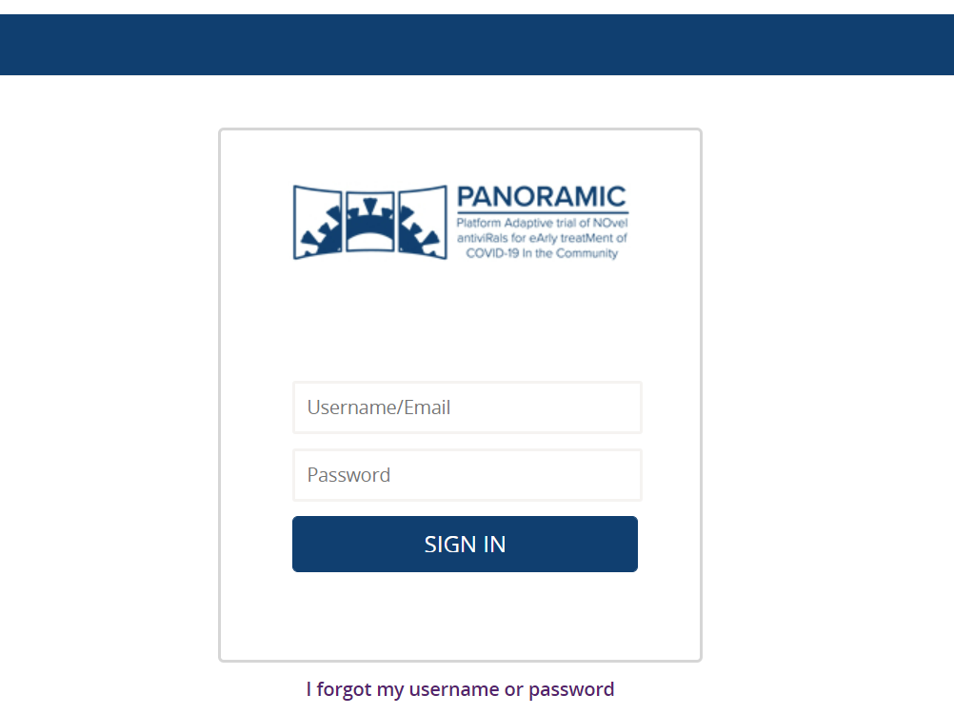
Data Collection
All data will be collected electronically using Spinnaker database containing:
Participant Login Pages for randomised participants where Daily Diary and 3/6 Month Follow Up forms will be completed.
Team Pages for signed in users.
Site users will be provided with unique log in details that will enable them to access Team Pages.
Refer to Spinnaker manual and attend training session!

Slide 28
Virology sub-study
Enhanced monitoring of a subset of participants who additionally volunteer for this aspect of the trial in each arm of the trial.
Recruitment will be from Hubs who have agreed to take part in the virology sub-study or through the central trial team
The first 30 patients from each trial arm will undergo intensive daily viral load monitoring. The remaining 270 participants will undergo less intensive monitoring involving 3 nasopharyngeal swabs.
All virology participants will be asked to provide 3 finger prick blood spot samples.

Slide 29
Methods of recruitment
PANORAMIC hubs: includes GP sites, community trusts, and other health service providers
Central recruitment: Currently in set-up. Will allow participants to be recruited via the trial website or free-phone telephone number
CMDU sites: Either acting as hubs to directly recruit participants or refer potential participants to the study website
Arrangements differ among devolved nations

Slide 30
Interested in taking part or want to find out more?
Please contact the trial team by emailing panoramic@phc.ox.ac.uk and we can arrange an individual meeting or send you an Expression of Interest form which will help us to assess whether your site can feasibly deliver the trial.

Slide 31
Useful Contact Details
PANORAMIC Main Inbox – panoramic@phc.ox.ac.uk
PANORAMIC NHS.net Inbox (For Participant Identifiable Information) – panoramic@nhs.net
PANORAMIC Safety Email - panoramic-safety@phc.ox.ac.uk
The PANORAMIC Trial Team Tel: 0808 156 0017
PANORAMIC Main website - https://www.panoramictrial.org/

Slide 32
Thank you for listening
Any questions? …

